Slide 1
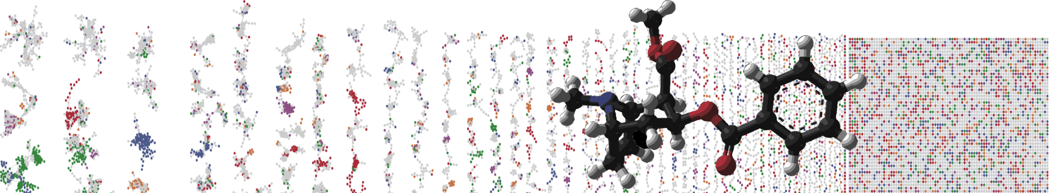


GNPS – LCMS Dashboard
HANDS ON
PRESENTER NAMES
University of California - San Diego

Slide 2
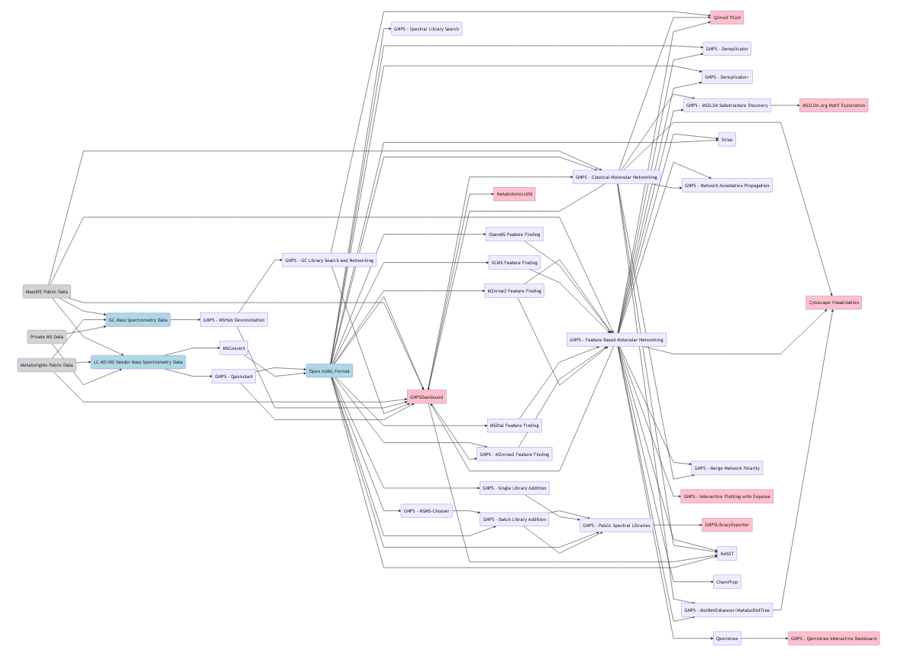

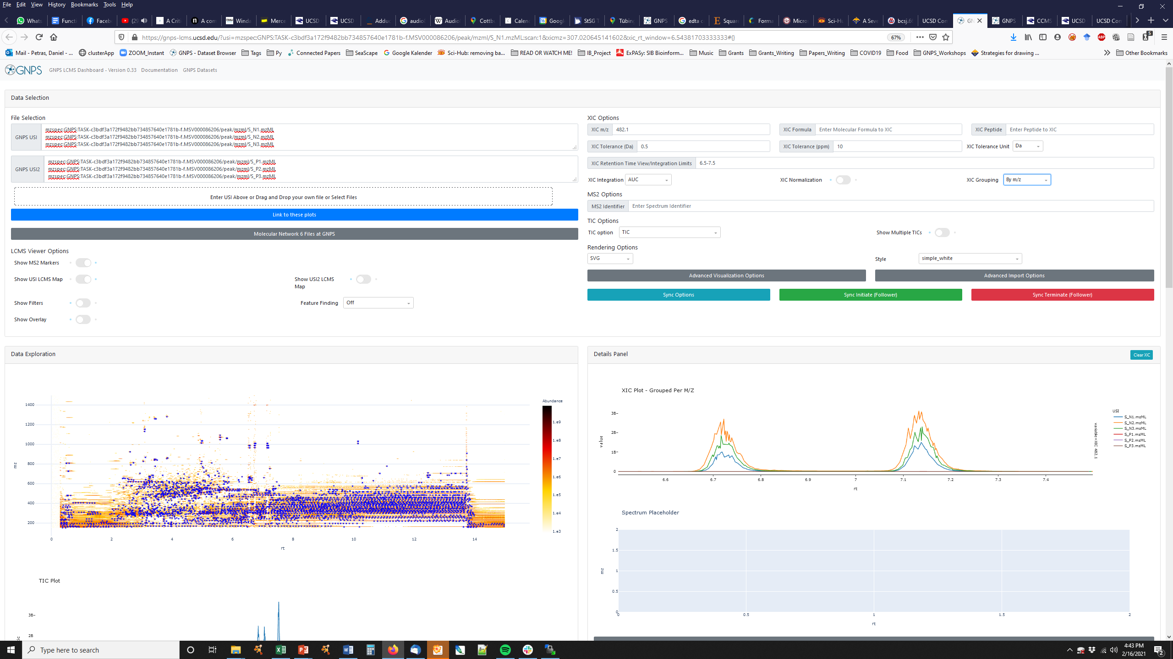
GNPS Workflows
Classic MN
Feature Finding
FBMN
Data
Dashboard
MASST

Slide 3
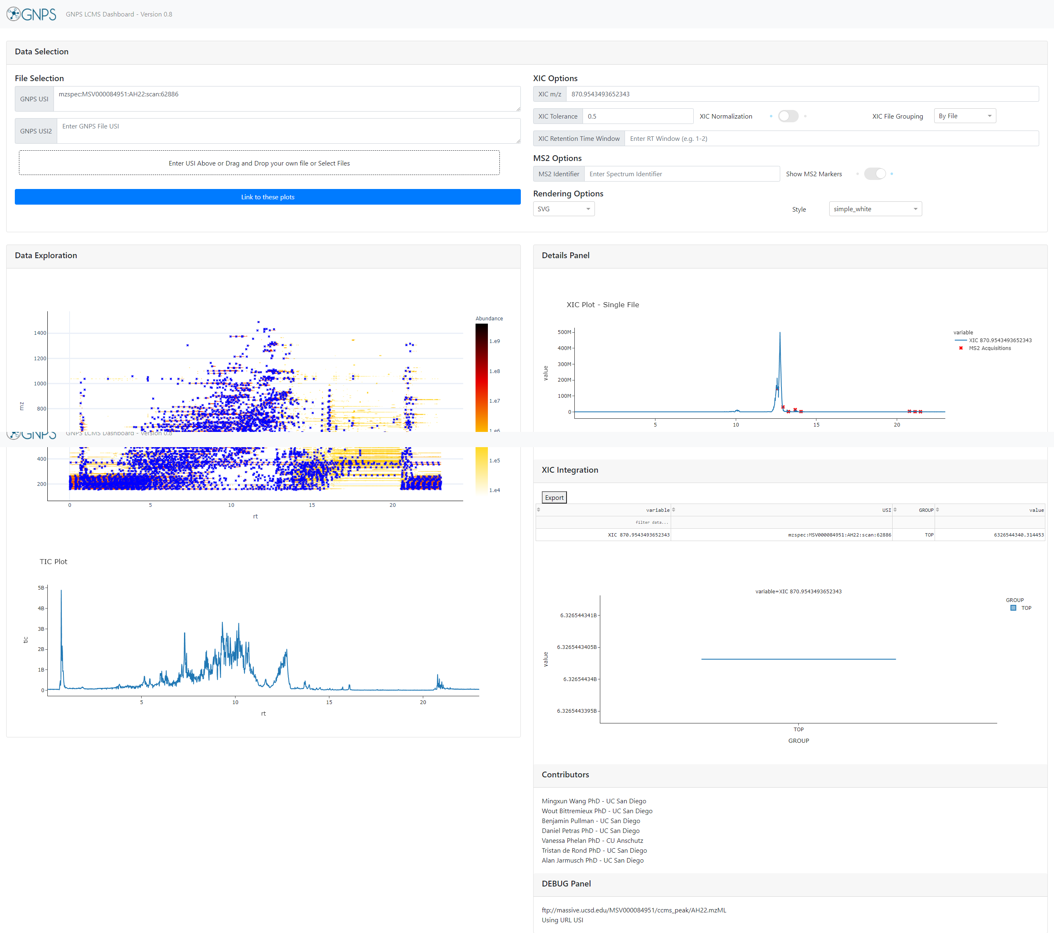

Interactively Exploring LCMS Data
Full LC/MS Mass Spec File
Visualize

Slide 4
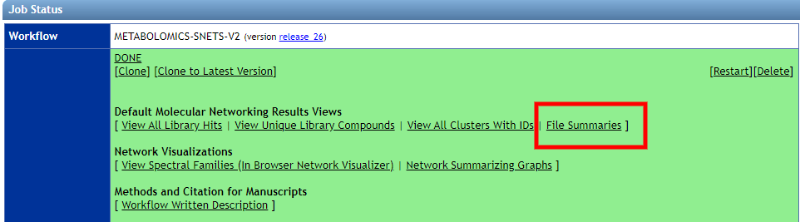
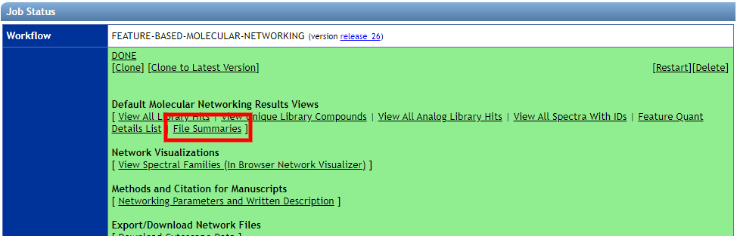
Selecting Data from GNPS Jobs
Classical Molecular Networking
Example Link
FBMN
Example Link

Slide 5
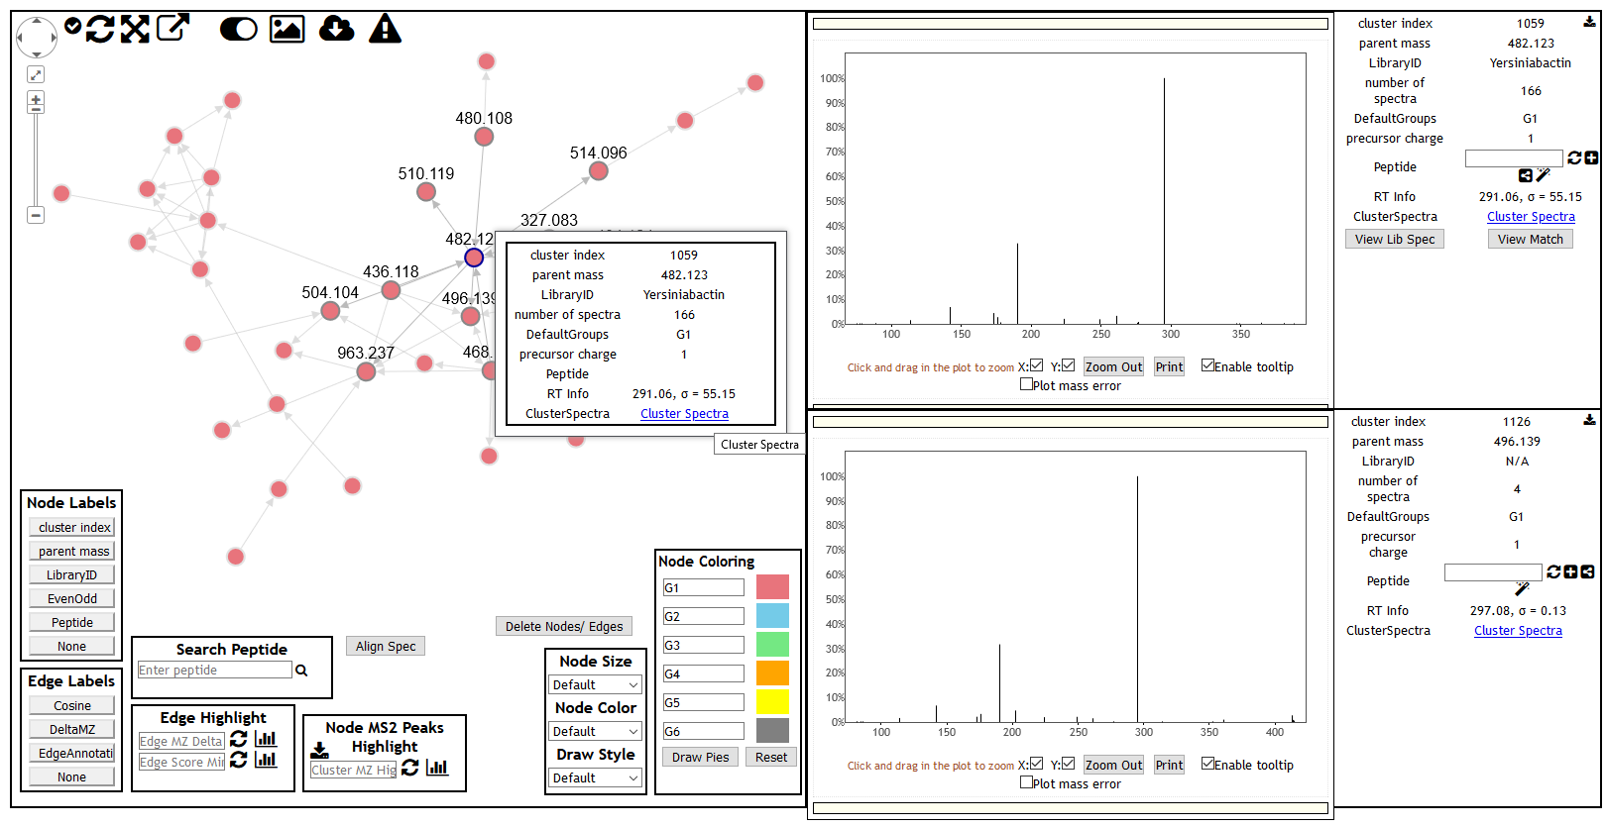
Selecting Data from Classic MN

Slide 6
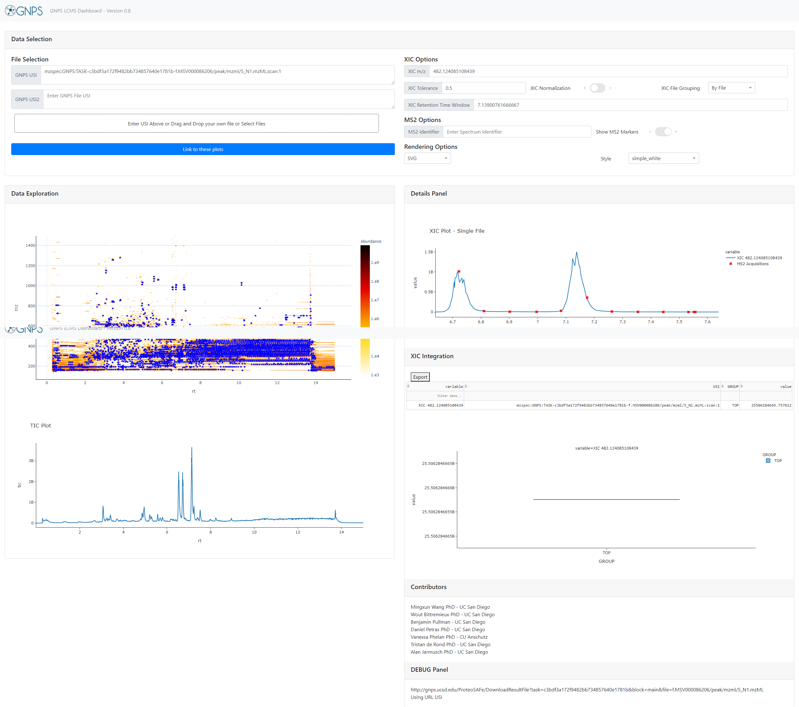
Visualizing in Interface
1.
2.
Data Selection
XIC Plotting Options
2D LCMS Heat Map
TIC Plot
XIC Plots/MS2 Plots
XIC Integration Results/Boxes
3.
5.
6.
4.
Example Link

Slide 7
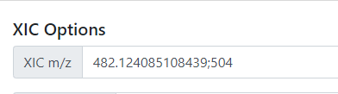
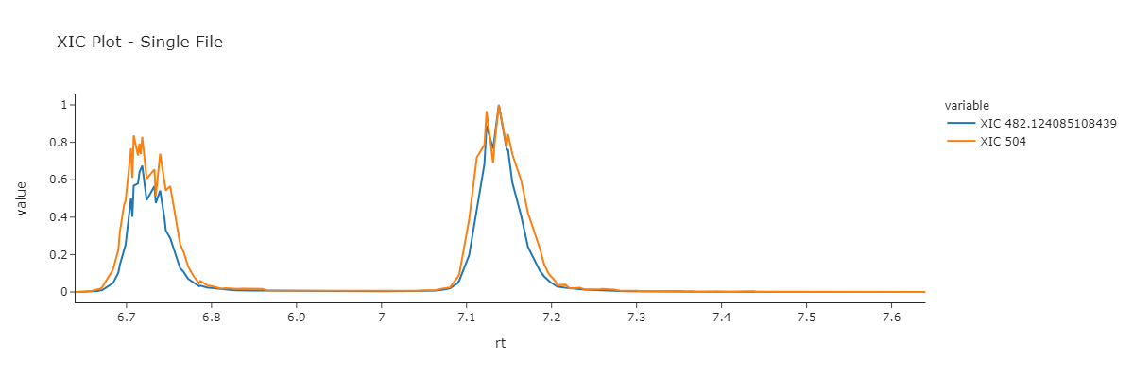
XIC on Multiple m/z
Example Link

Slide 8
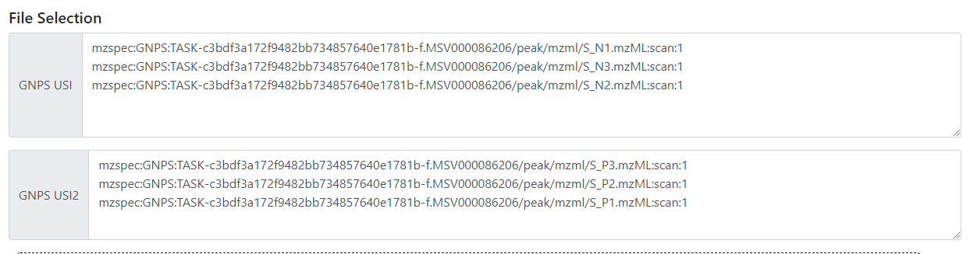
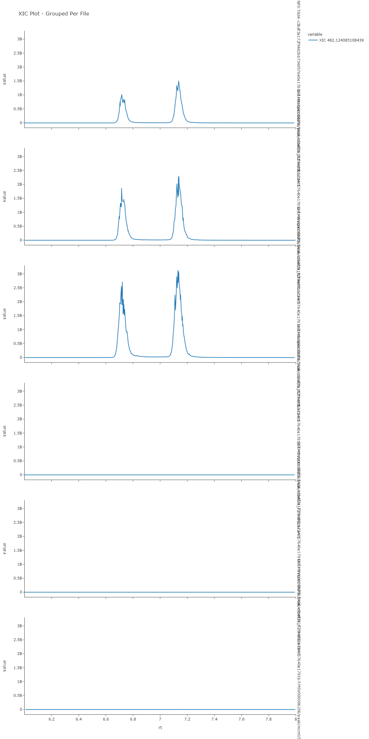
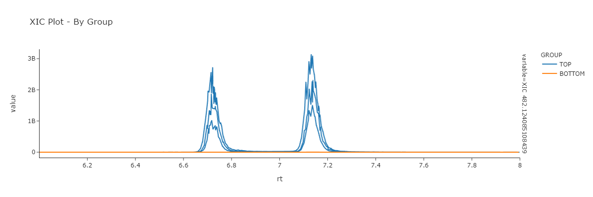
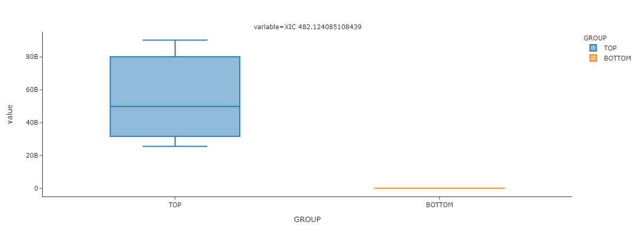
XIC Comparison on Multiple Files
Example Link

Slide 9
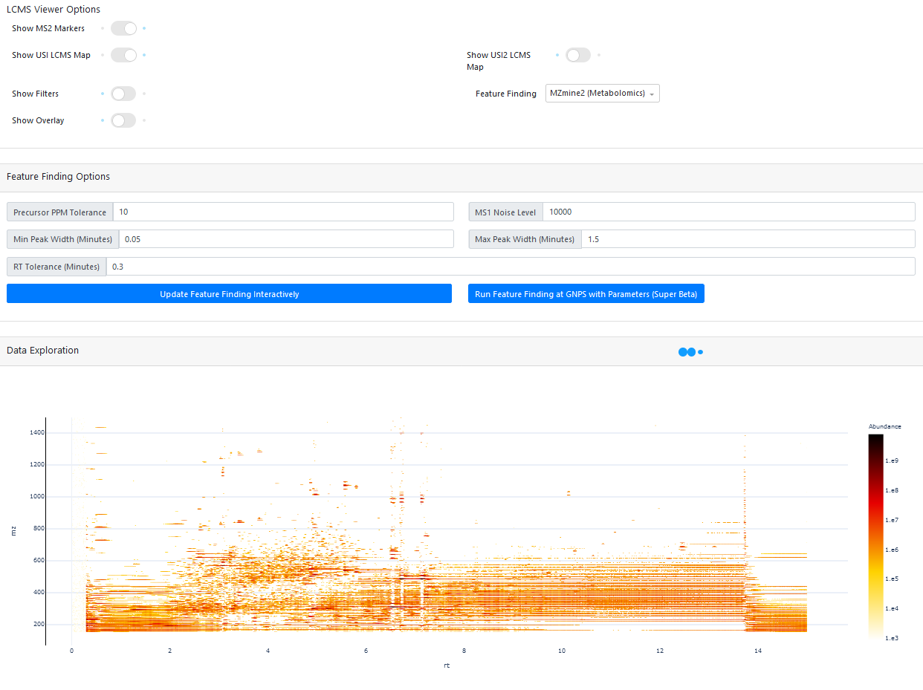
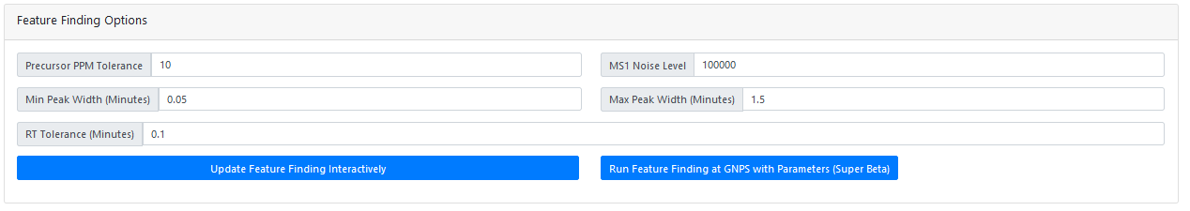
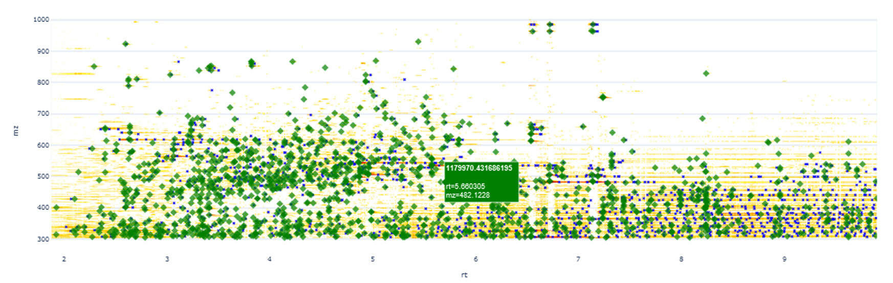
FBMN through Dashboard

Slide 10
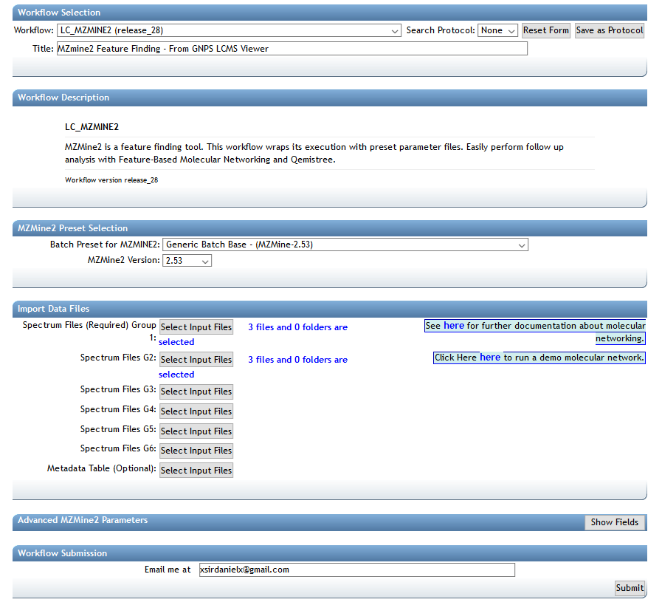
FBMN through Dashboard
Example Link

Slide 11
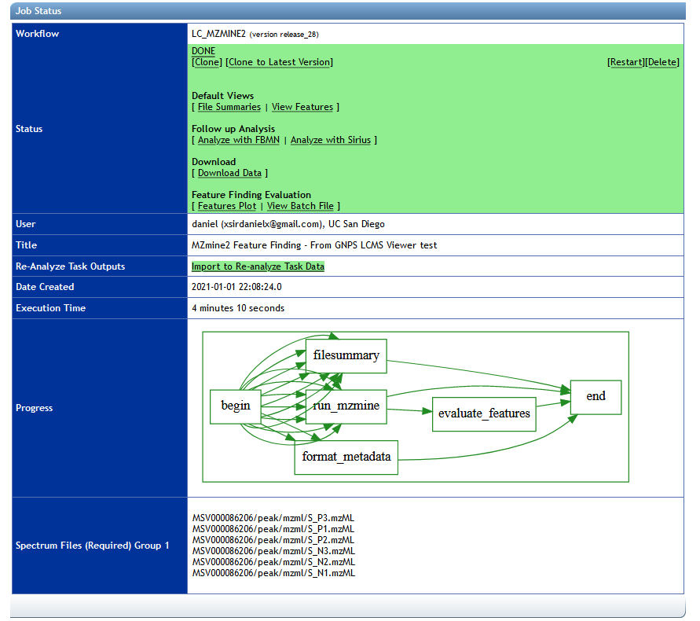
FBMN through Dashboard
Example Link

Slide 12
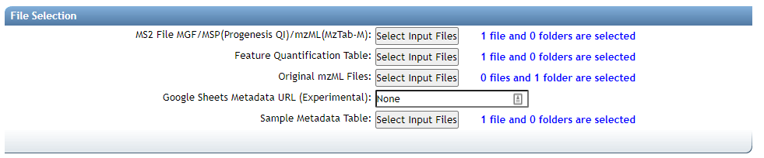
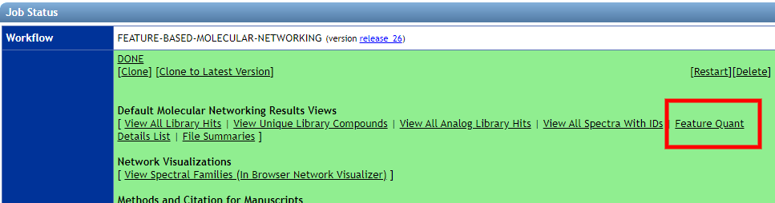
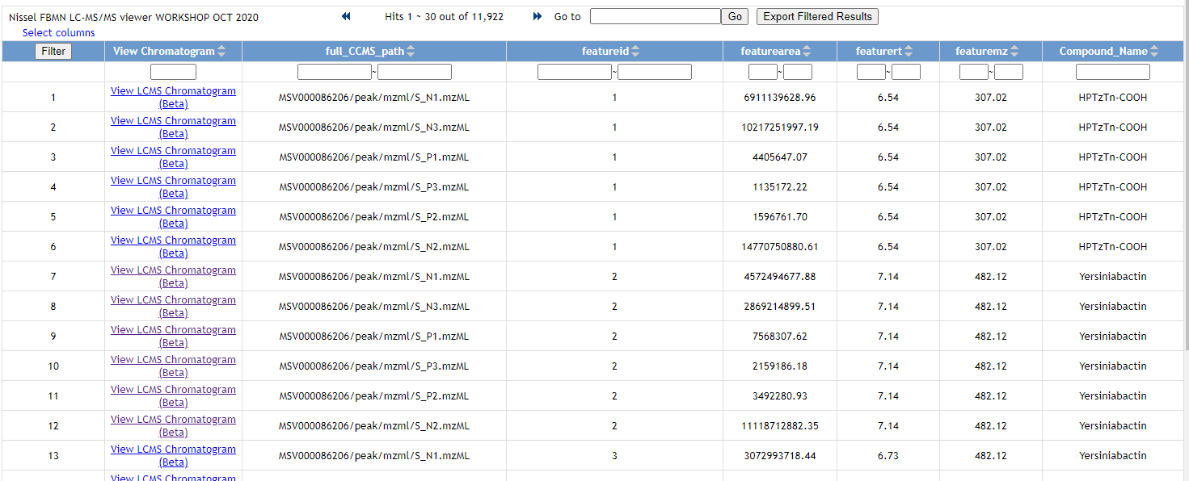
Inspecting Feature Finding Results from FBMN
Select All Original mzML Files
View Feature Quant Details List
Listing All Features across all files
Example Link

Slide 13
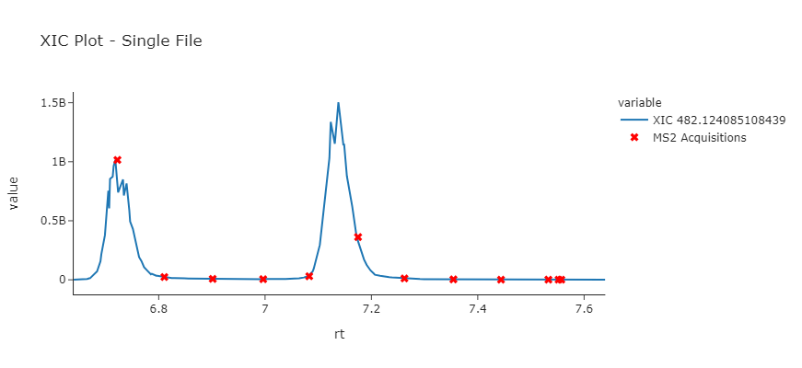
Inspecting Feature Finding Results from FBMN
Listing All Features across all files
Easily View Each Feature
Example Link

Slide 14
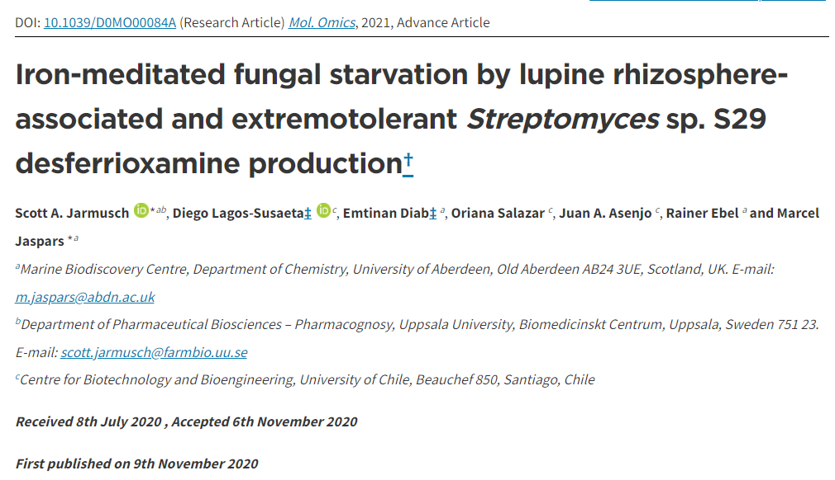
Validating Publications Results
https://pubs.rsc.org/en/content/articlehtml/2020/mo/d0mo00084a

Slide 15
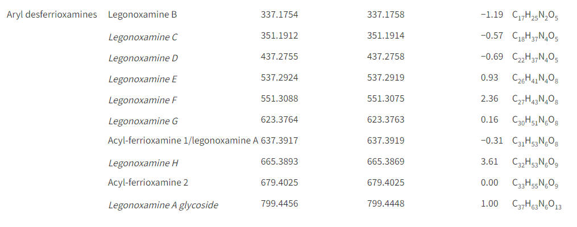
Validating Publications Results
Table 1 – Summary of siderophores identified using
molecular networking and manual observations of the data (italicized identified in this study)

Slide 16
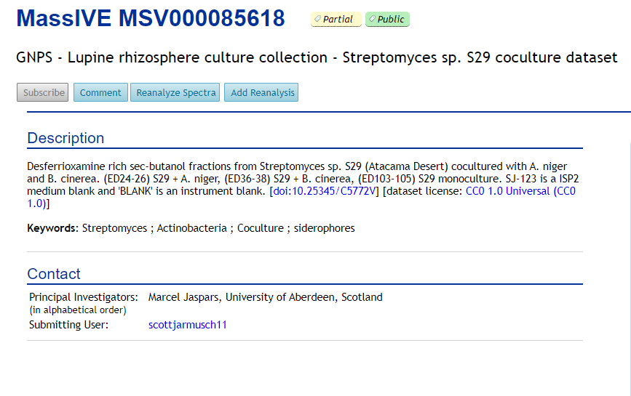
Validating Publications Results

Slide 17
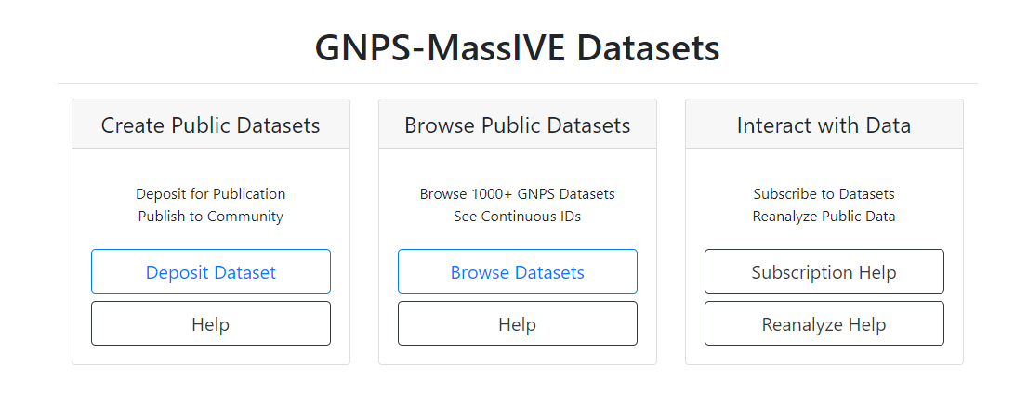
Browsing Dataset Files with Metadata
Go to https://gnps.ucsd.edu
MSV000085618

Slide 18
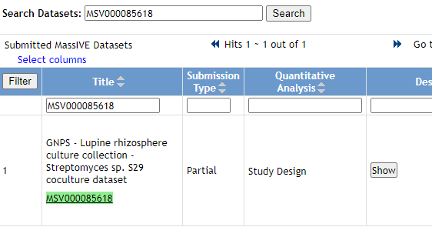
Browsing Dataset Files with Metadata
Search for MSV000085618

Slide 19
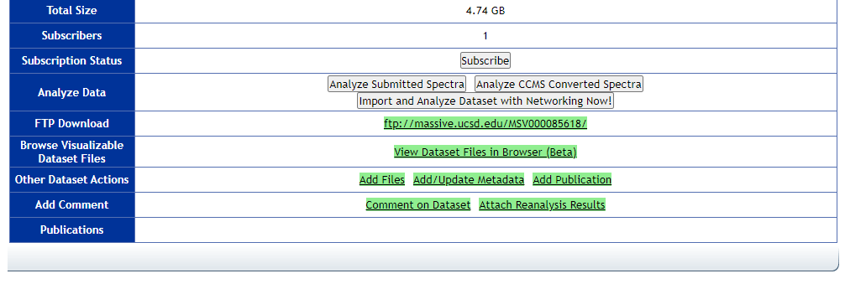
Browsing Dataset Files with Metadata
Browse Dataset Files

Slide 20
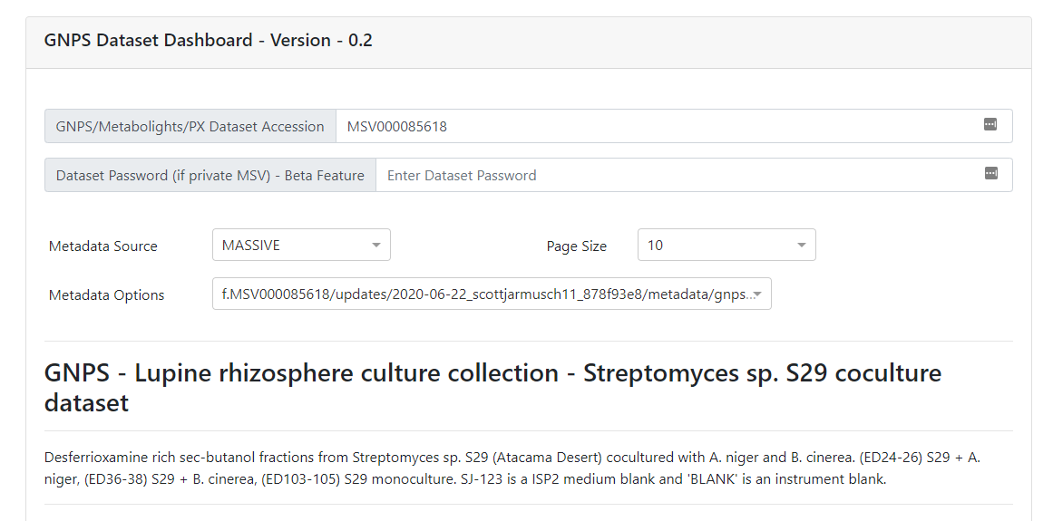
Browsing Dataset Files with Metadata
Select MASSIVE Metadata Source
Link

Slide 21
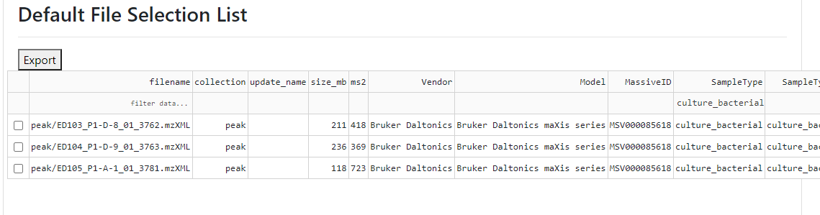
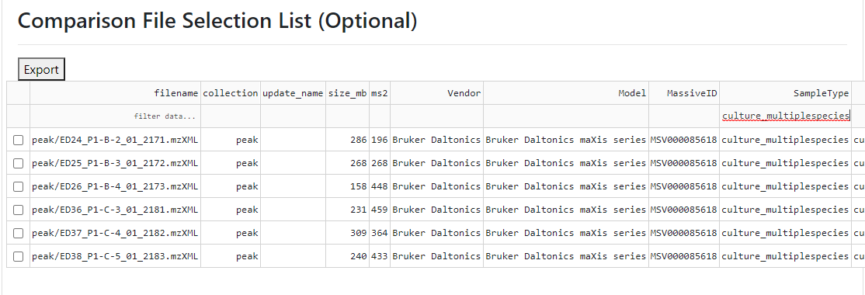
Browsing Dataset Files with Metadata
Selecting Cultures vs Co-Cultures

Slide 22
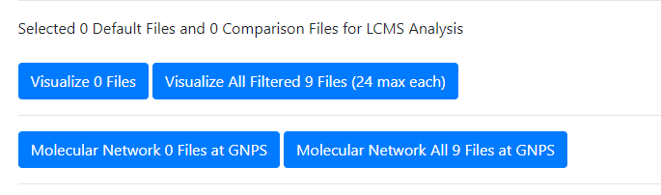
Browsing Dataset Files with Metadata
Lets go view it

Slide 23
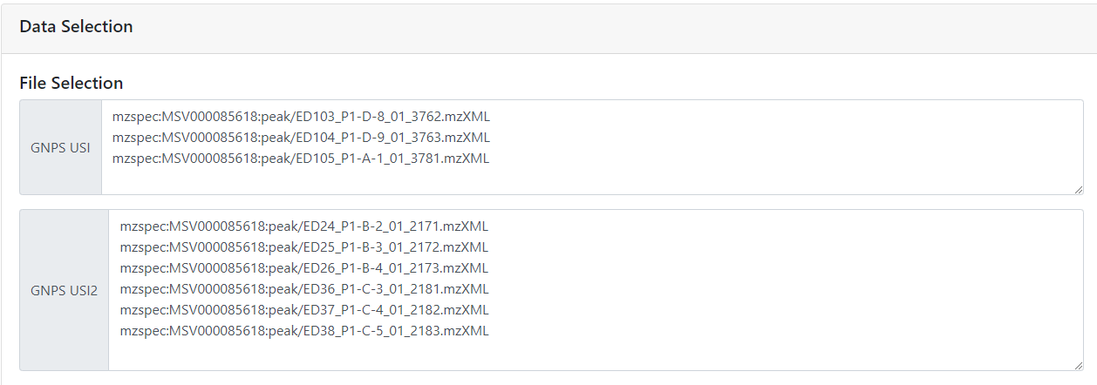
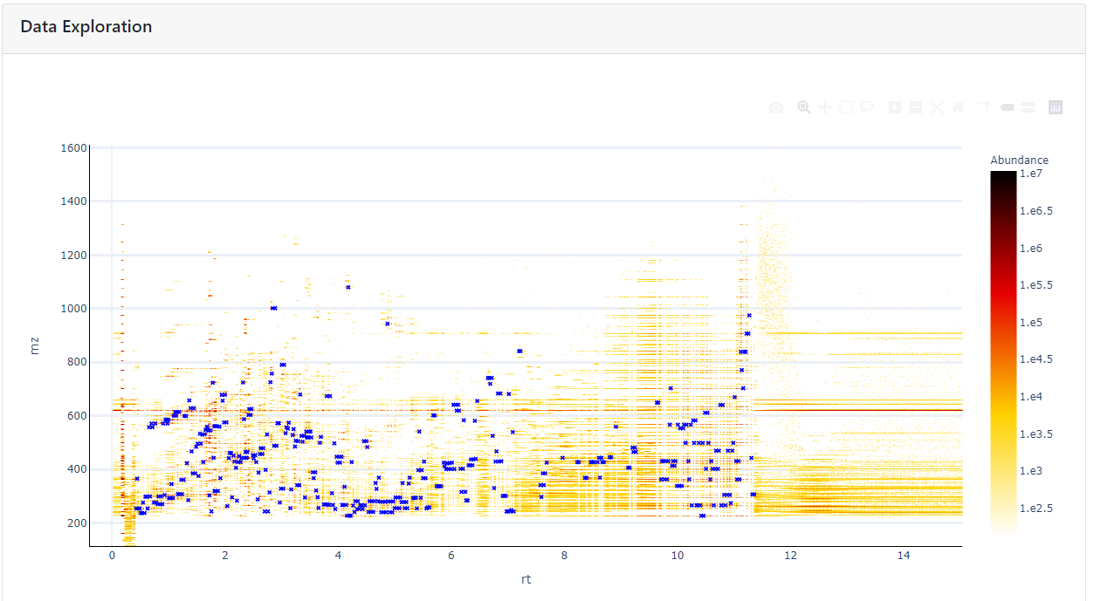
Viewing Files in GNPS Dashboard
Viewing two groups of samples - Link

Slide 24
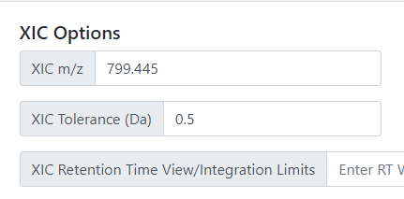
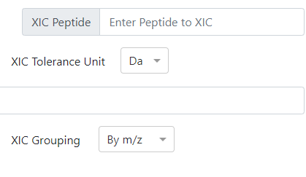
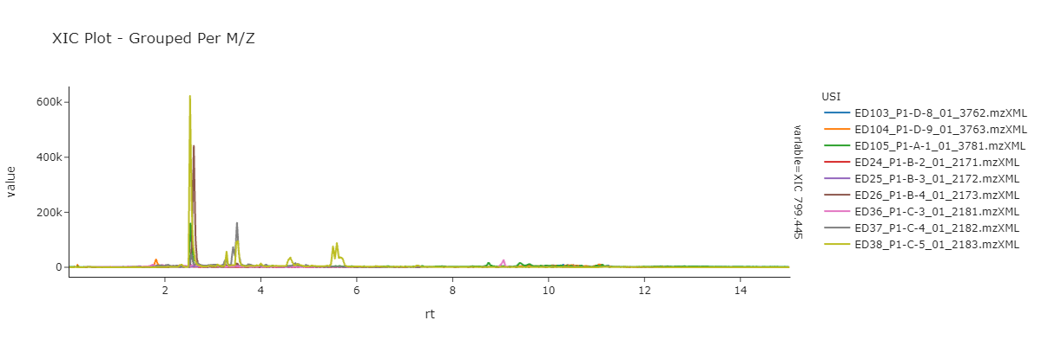
Browsing Dataset Files with Metadata
Enter the XIC
Group by m/z

Slide 25
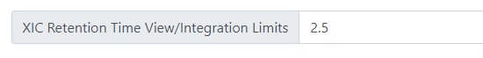
Browsing Dataset Files with Metadata
Set the XIC Integration Limits

Slide 26
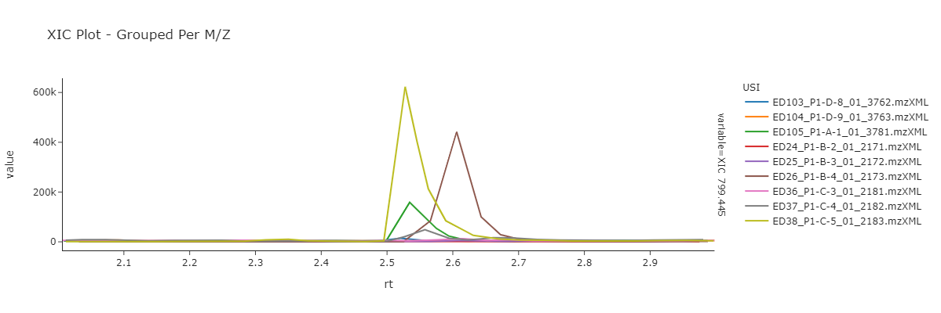
Browsing Dataset Files with Metadata
Set the XIC Integration Limits

Slide 27
Browsing Dataset Files with Metadata
Found in mono cultures of streptomyces as well as co-cultures. Consistent within manuscript!
Link

Slide 28
Questions, Problems or Bugs?
Documentation: https://ccms-ucsd.github.io/GNPSDocumentation/
Forum: https://groups.google.com/forum/#!forum/molecular_networking_bug_reports
PRESENTER NAMES AND EMAILS HERE

